Slide 1
Introduction to Mysql’s case studies
By Nouf Al-ruhaili, Maram Al-shehri, Nourah Al-saadan

Slide 2
Contants
Case 1: Equality
Case 2: Covid 19
Case 3: Bonuses

Slide 3



The 1st case: Equality

Slide 4

The company want to asses its gender equality employment policy and by looking into the number of male and female employees in the company.
The 1st case: Equality
 | Number_of_employees | Ratio_males_to_females
Males | 179973 | 60.4136
Females | 120051 | 39.5864
Total | 300024 | 100
Gap | 59922 | 20.8272
AVG salary is equal for both males and females = | $ 63,769.12

Slide 5
The company want to asses its gender equality employment policy and by looking into the number of male and female employees in the company.
The 1st case: Equality
The departments gaps list
Department name | M_ratio | F_ratio | Gap
Human Resources | 62.1801 | 37.8199 | 24.3602
Research | 60.9122 | 39.0878 | 21.8244
Markiting | 60.6383 | 39.3617 | 21.2766
Sales | 60.6215 | 39.3785 | 21.243
Customer Service | 60.5573 | 39.4427 | 21.1146
Finance | 60.5123 | 39.4877 | 21.0246
Development | 60.4111 | 39.5889 | 20.8222
Production | 60.164 | 39.836 | 20.328
Quality Management | 58.9302 | 41.0698 | 17.8604

Slide 6
The company want to asses its gender equality employment policy and by looking into the number of male and female employees in the company.
The 1st case: Equality
The plan is to hire 10,000 in the 1st year and increase them by 10,000 Yearly
 | Years
Employment | 10000 | 20000 | 30000 | 40000 | 50000
The number of the females employees to be equal to the males = |  |  |  |  | 104961

Slide 7

The 2nd case: Covid 19

Slide 8
Due to COVID-19 the company wants to downsize its employees to save 20% of the total salaries it pays annually.
The 2nd case: Covid 19
Total 0f employee's salaries | $ 5,956,616,054.00
20% reduction | $ 1,191,323,210.80
dept_name | Avg_salary | Sum_of_emp_salaries | 20% Reduction | Salary after Reduction
Marketing | $ 60,980.28 | $ 411,068,070.00 | $ 82,213,614.00 | $ 328,854,456.00
Finance | $ 59,307.95 | $ 350,332,038.00 | $ 70,066,407.60 | $ 280,265,630.40
Human Resources | $ 44,610.04 | $ 272,299,668.00 | $ 54,459,933.60 | $ 217,839,734.40
Production | $ 48,683.08 | $ 1,218,391,429.00 | $ 243,678,285.80 | $ 974,713,143.20
Development | $ 48,721.22 | $ 1,417,056,754.00 | $ 283,411,350.80 | $ 1,133,645,403.20
Quality Management | $ 46,437.57 | $ 313,500,038.00 | $ 62,700,007.60 | $ 250,800,030.40
Sales | $ 69,954.16 | $ 1,236,929,452.00 | $ 247,385,890.40 | $ 989,543,561.60
Research | $ 48,958.48 | $ 349,906,291.00 | $ 69,981,258.20 | $ 279,925,032.80
Customer Service | $ 48,031.30 | $ 387,132,314.00 | $ 77,426,462.80 | $ 309,705,851.20
Total | $ 475,684.09 | $ 5,956,616,054.00 | $ 1,191,323,210.80 | $ 4,765,292,843.20

Slide 9

The 3rd case: Bonuses

Slide 10
The company wants to offer bonuses at the end of the year to reward its employees. The total bonus paid to all the employees should not exceed $50 millions.
The 3rd case: Bonuses
Bonuses senario
1- Bonuses based on the equality of the AVG salaries
2- Bonuses based on the serving years (Experiences)
o If the serving years are +10 the bonus will be 10% of the salary
o If the serving years are between 7,10 the bonus will be 7.5% of the salary
o If the serving years are between 4,6 the bonus will be 5% of the salary
3- 20% Bonuses for the employees whom contarct will be expired by Feb 1st 2001
4- The total bonuses | $ 7,596,934.83

Slide 11


Thanks for your attention Any Questions ?

Slide 12
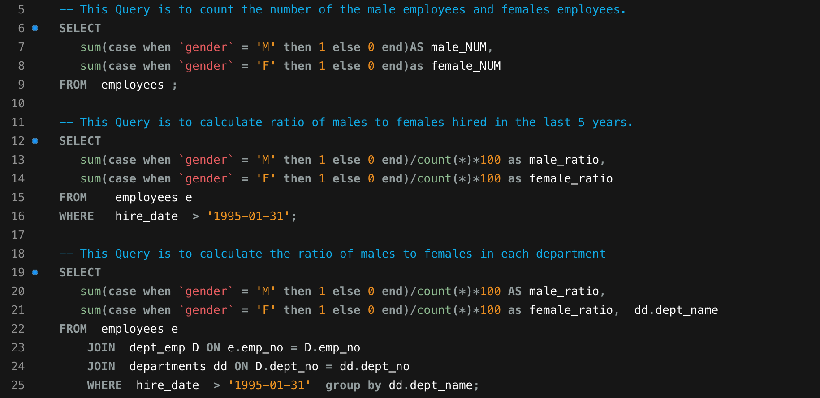
The 1st case: Equality
Back

Slide 13
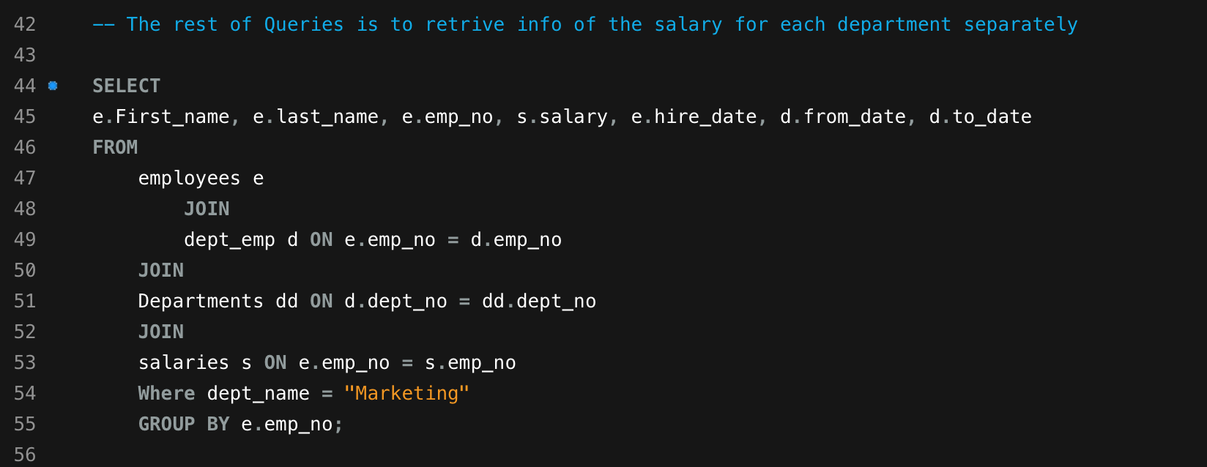
The 2nd case: Covid 19
Back

Slide 14
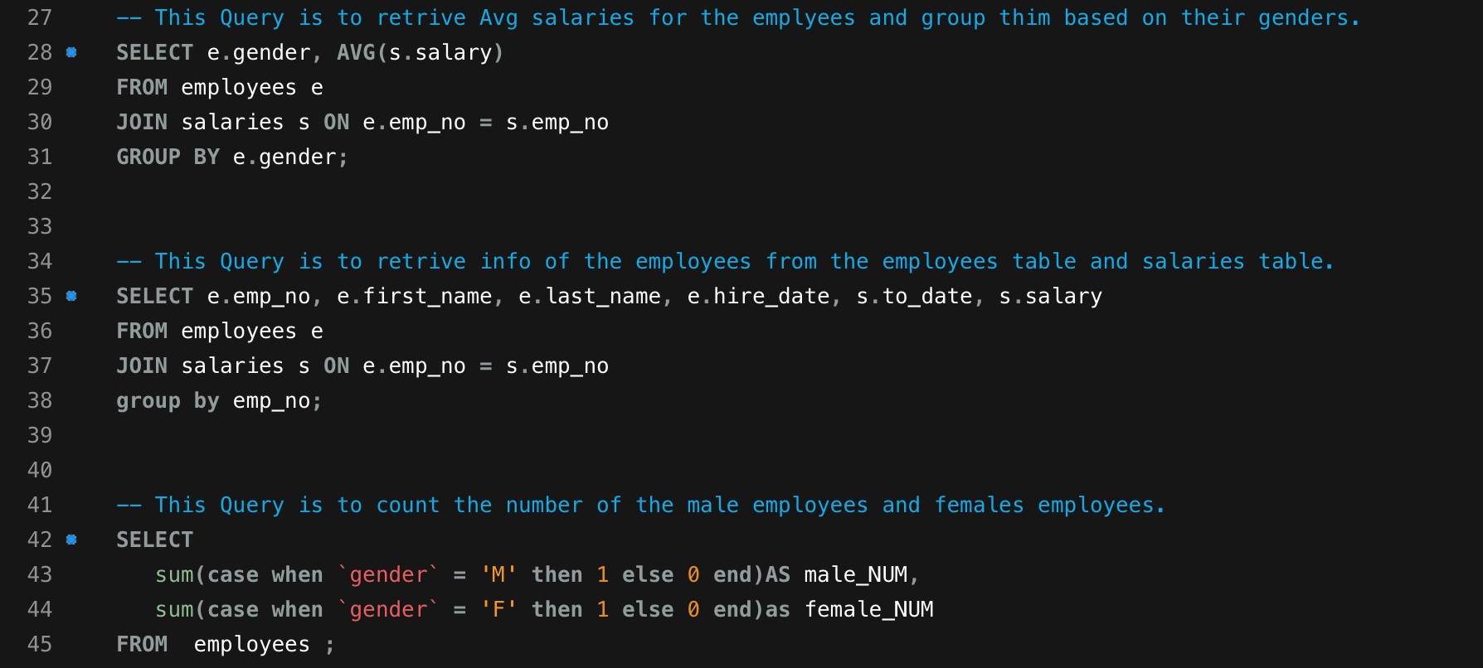
The 3rd case: Bonuses
Back

